Slide 1
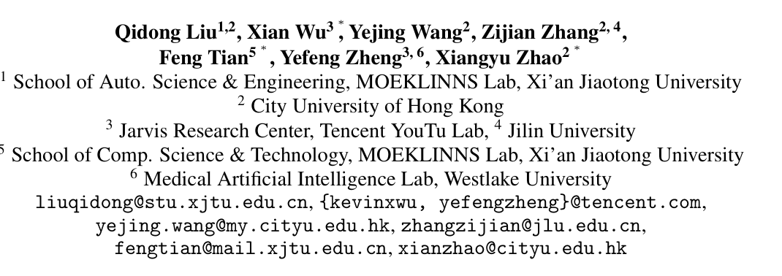
ATAI
Advanced Techniqueof Artificial Intelligence
ATAI
ChongqingUniversity _{AdvancedTechniqueof}
of Technology Artificial Intelligence
Chongqing University of
Technology
Chongqing University ^{ATAI}
_{of Technology} Advanced Techniqueof
Artificial Intelligence
Chongqing University of Technology
Chongqing University of Technology
LLM-ESR: Large Language Models Enhancement for
Long-tailed Sequential Recommendation
Code:https://github.com/Applied-Machine-Learning-Lab/LLM-ESR
2024.11.28•ChongQing
——NeurIPS2024
Reported by Jinfei Chen
1

Slide 2
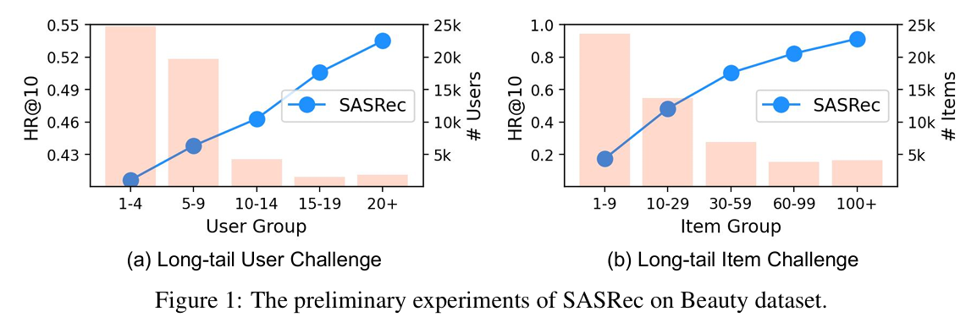
ATAI
AdvancedTechniqueof
Artificial Intelligence
ATAI
ChongqingUniversity _{AdvancedTechniqueof}
of Technology Artificial Intelligence
ChongqingUniversity of Technology
Motivation
Sequential recommender systems (SRS) face challenges from long-tail users (few interactions) and long-tail items (insufficient data), which degrade recommendation quality and user experience. Existing methods struggle with seesaw effects and noise due to data scarcity.

Slide 3
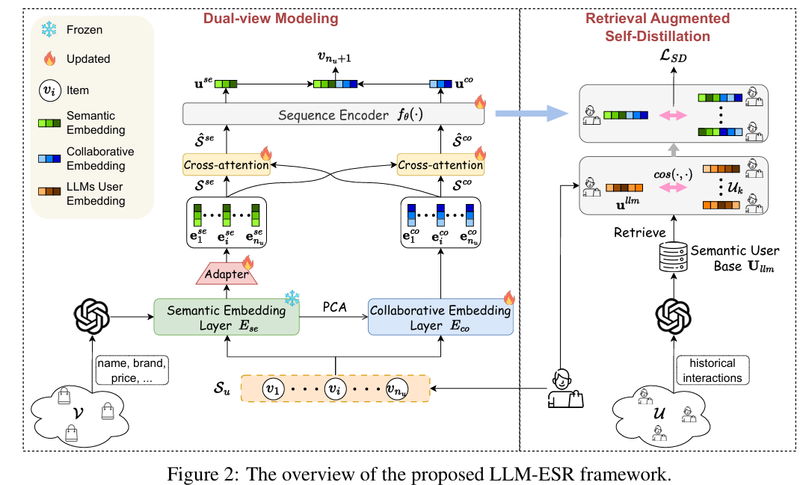
ChongqingUniversity of Technology
ATAI
AdvancedTechniqueof
Artificial Intelligence
ATAI
ChongqingUniversity _{AdvancedTechniqueof}
of Technology Artificial Intelligence
Overview

Slide 4
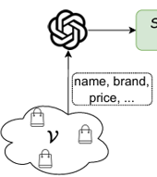
ChongqingUniversity of Technology
ATAI
AdvancedTechniqueof
Artificial Intelligence
ATAI
ChongqingUniversity _{AdvancedTechniqueof}
of Technology Artificial Intelligence
Overview

Slide 5
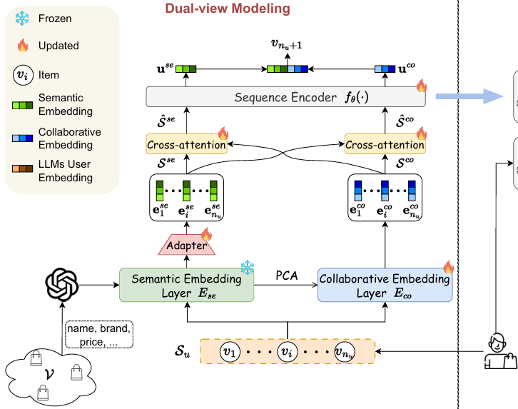
ChongqingUniversity of Technology
ATAI
AdvancedTechniqueof
Artificial Intelligence
ATAI
ChongqingUniversity _{AdvancedTechniqueof}
of Technology Artificial Intelligence
Method

Slide 6
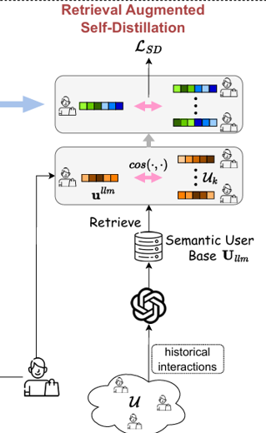
ChongqingUniversity of Technology
ATAI
AdvancedTechniqueof
Artificial Intelligence
ATAI
ChongqingUniversity _{AdvancedTechniqueof}
of Technology Artificial Intelligence
Method

Slide 7
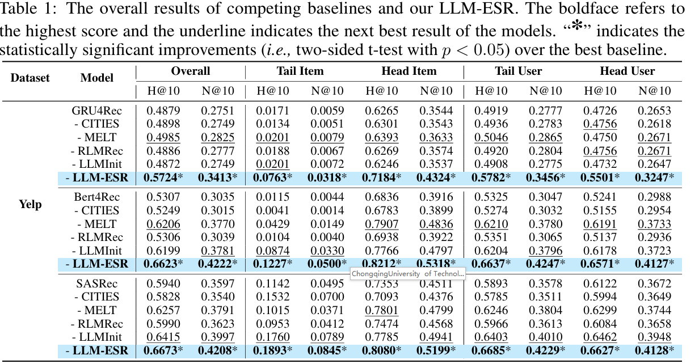
ATAI
AdvancedTechniqueof
Artificial Intelligence
ATAI
ChongqingUniversity _{AdvancedTechniqueof}
of Technology Artificial Intelligence
ChongqingUniversity of Technology
Experiments

Slide 8
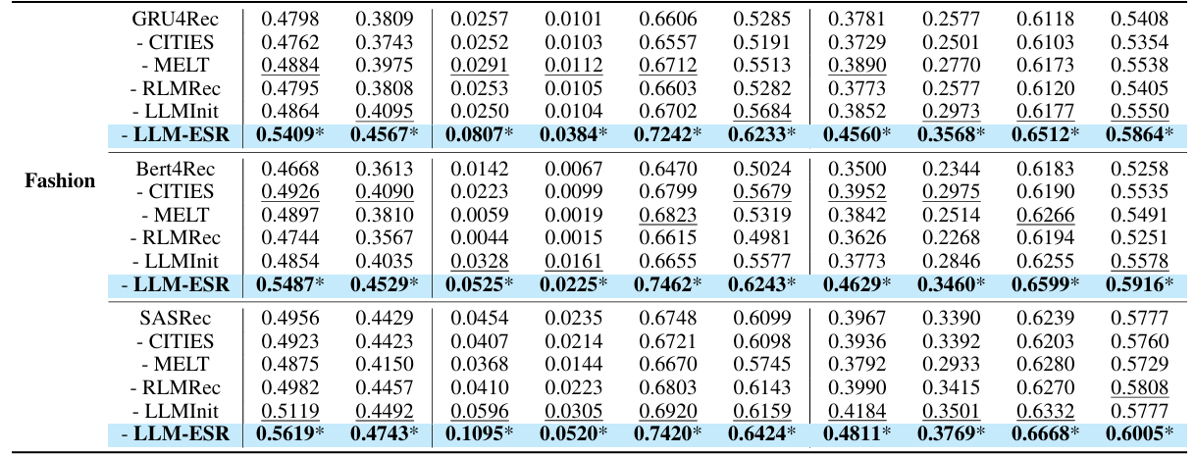
ATAI
AdvancedTechniqueof
Artificial Intelligence
ATAI
ChongqingUniversity _{AdvancedTechniqueof}
of Technology Artificial Intelligence
ChongqingUniversity of Technology
Experiments

Slide 9
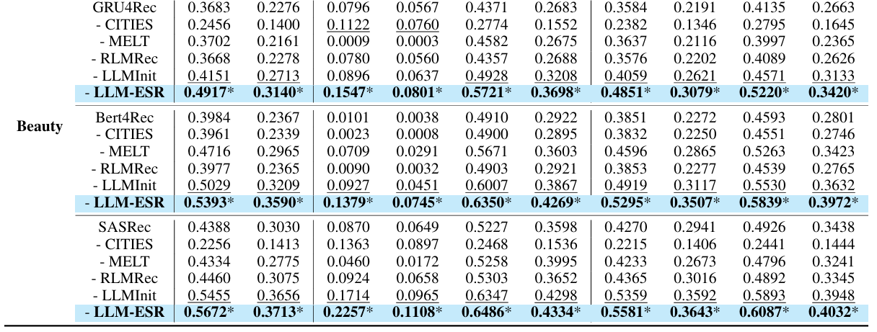
ATAI
AdvancedTechniqueof
Artificial Intelligence
ATAI
ChongqingUniversity _{AdvancedTechniqueof}
of Technology Artificial Intelligence
ChongqingUniversity of Technology
Experiments

Slide 10
ATAI
AdvancedTechniqueof
Artificial Intelligence
ATAI
ChongqingUniversity _{AdvancedTechniqueof}
of Technology Artificial Intelligence
ChongqingUniversity of Technology
Experiments

Slide 11
ATAI
AdvancedTechniqueof
Artificial Intelligence
ATAI
ChongqingUniversity _{AdvancedTechniqueof}
of Technology Artificial Intelligence
ChongqingUniversity of Technology
Experiments

Slide 12
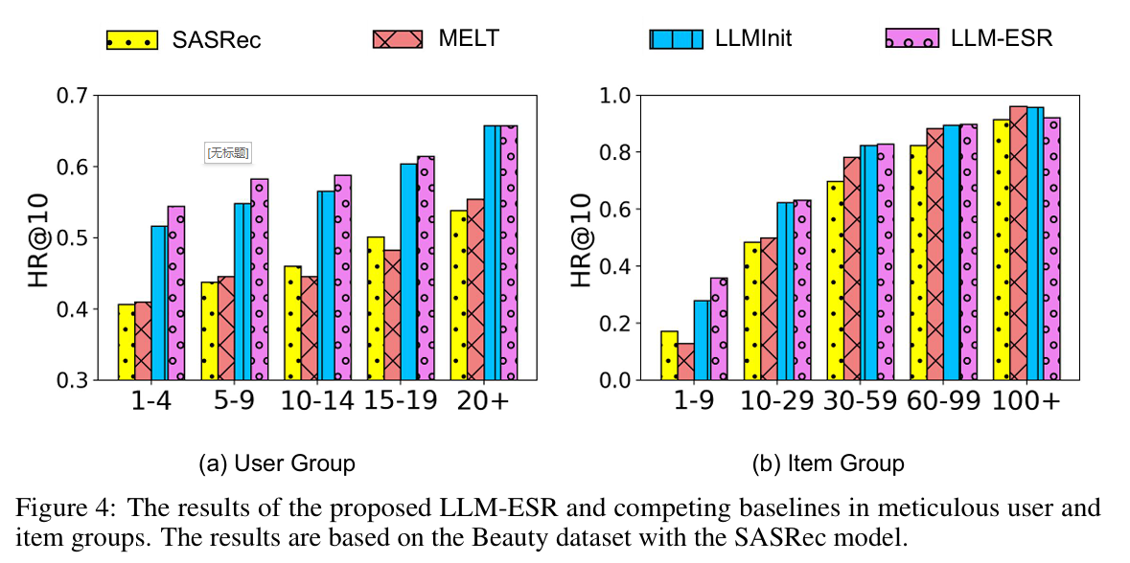
ATAI
AdvancedTechniqueof
Artificial Intelligence
ATAI
ChongqingUniversity _{AdvancedTechniqueof}
of Technology Artificial Intelligence
ChongqingUniversity of Technology
Experiments

Slide 13
ChongqingUniversity of Technology
ATAI
AdvancedTechniqueof
Artificial Intelligence
ATAI
ChongqingUniversity _{AdvancedTechniqueof}
of Technology Artificial Intelligence
Thanks!

